Slide 1


WORLD UNIVERSITY OF BANGLADESH
Department of Computer Science and Engineering
Early Detection of Heart Failure through Machine
Learning with Explainable Artificial Intelligence
Md. Tohidul Islam
Mahfuz Sarker
Md. Ibrahim Khan
WUB 03/23/63/3741
WUB 03/23/63/3748
WUB 03/23/63/3750
Supervised by Md. Raihanul Haque, Lecturer, Dept. of CSE, World University of Bangladesh
JUNE 2026

Slide 2


Abstract
887
Heart failure is one of the leading causes of death worldwide, making early detection critically important. This thesis proposes a machine learning-based framework using 887 patient records to detect heart failure at an early stage. Seven classification algorithms were trained and evaluated including Logistic Regression, Decision Tree, Random Forest, XGBoost, LightGBM, Gradient Boosting, and AdaBoost. Among all models, LightGBM achieved the best performance with 91.01% accuracy and 94.66% ROC-AUC. Explainable AI techniques SHAP and LIME were applied to interpret predictions, revealing that ST_Slope, ChestPainType, and Sex are the most influential features for heart failure prediction.
PATIENT RECORDS
7
ML ALGORITHMS
91.01%
BEST ACCURACY (LIGHTGBM)
SHAP + LIME
EXPLAINABILITY METHODS
02 / 15

Slide 3


Introduction
Heart failure affects more than 64 million people globally. Traditional diagnostic methods are costly, time-consuming, and not always accessible in developing countries like Bangladesh.
Machine Learning can analyze large volumes of patient data and assist clinicians in early heart failure risk assessment. However, most ML models are black-box models, making their decisions difficult to understand.
This thesis proposes an early heart failure detection system combining powerful Machine Learning models with Explainable AI techniques such as SHAP and LIME to ensure accurate and transparent predictions.
64M+
PEOPLE AFFECTED BY HEART FAILURE GLOBALLY (WHO)
Early detection enables timely intervention — the core motivation for this thesis.
03 / 15

Slide 4





Objectives
Model Development
Data Preprocessing
Implement and compare seven classification algorithms including Logistic Regression, Decision Tree, Random Forest, XGBoost, LightGBM, Gradient Boosting, and AdaBoost.
Apply invalid entry removal, label encoding, feature engineering, and SMOTE oversampling to improve data quality and balance.
Performance Evaluation
Model Explainability
Assess each model with accuracy, precision, recall, F1 score, ROC-AUC, and 10-fold cross-validation for unbiased results.
Apply SHAP and LIME to the best-performing model to explain predictions at both global and local levels.
04 / 15

Slide 5





Description of the Problem
Late & Costly Diagnosis
The Black-Box Problem
Heart failure often goes undetected until a critical stage. Conventional diagnostics are expensive, slow, and require specialist expertise that is scarce in resource-limited regions like Bangladesh.
Top-performing ensemble models such as Random Forest, XGBoost, and LightGBM are opaque. Clinicians cannot see why a prediction was made, undermining trust and clinical adoption.
Imbalanced Training Data
Research Gap
Clinical datasets typically contain far fewer heart failure cases than healthy cases, biasing models toward the majority class unless explicitly corrected using techniques like SMOTE.
Very few existing studies combine multiple ensemble models with dual explainability using SHAP and LIME in one unified, clinically transparent framework. This is the gap this thesis addresses.
05 / 15

Slide 6


Scope of the Thesis
✅ IN SCOPE
Predicting whether a patient is at risk of heart failure or not based on routine clinical attributes.
Dataset of 887 valid patient records with 11 core clinical features (age, sex, chest pain type, blood pressure, cholesterol, ECG, etc.).
The complete pipeline from data preprocessing and feature engineering to model training, evaluation, and explainability was covered in this thesis.
Seven ML algorithms were compared and SHAP and LIME were applied to the best-performing model LightGBM to explain its predictions.
Dataset Snapshot
887
valid patient records (from 1,061 raw)
11 → 14
clinical features after engineering
51% / 49%
class balance (No HF / HF)
80 / 20
stratified train–test split
❌ OUT OF SCOPE
Source: Kaggle Heart Failure Prediction Dataset (V, 2024), validated in peer-reviewed research (Liu et al., 2025).
The system was not deployed in any real hospital or clinical environment.
Medical imaging data such as Echo and MRI were not used in this thesis.
06 / 15

Slide 7

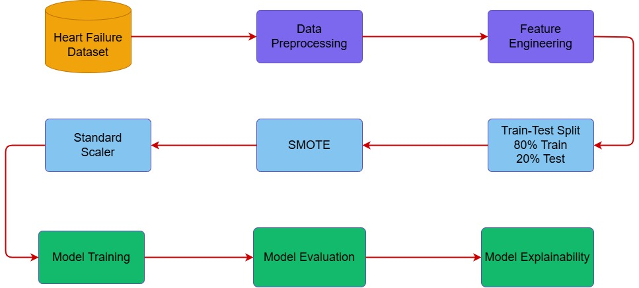


Methodology
A structured end-to-end ML pipeline from data collection to model explainability was followed for early heart failure detection using 887 patient records.
KEY TECHNIQUES
Data Cleaning — Removed 174 invalid records with zero cholesterol and blood pressure values
Feature Engineering — Created 3 new features: Age_MaxHR, BP_Cholesterol, and Risk_Score
SMOTE — Applied to balance the training data by generating synthetic samples
StandardScaler — Normalized all feature values to the same scale
7 Classifiers — Logistic Regression, Decision Tree, Random Forest, XGBoost, LightGBM, Gradient Boosting, and AdaBoost
10-Fold Cross Validation — Used for robust and unbiased model performance evaluation
07 / 15

Slide 8



Requirement Analysis
Functional Requirements
Non-Functional Requirements
Load and preprocess patient data including invalid entry removal, label encoding, and normalization.
Engineer 3 new features: Age_MaxHR, BP_Cholesterol, and Risk_Score.
Apply SMOTE to balance the training data.
Train and evaluate seven ML classification algorithms.
Generate performance reports including accuracy, precision, recall, F1 score, and ROC-AUC.
Apply SHAP and LIME to explain the best-performing model LightGBM.
Minimum accuracy of 85% for clinical acceptability.
High recall to minimize false negatives and avoid missing heart failure cases.
Reproducible results with fixed random seeds.
Transparent and interpretable predictions for clinical use.
Scalable pipeline capable of handling larger datasets.
08 / 15

Slide 9



Design & Development
Dataset Loading
Data Preprocessing
Exploratory Data Analysis
887 valid patient records loaded from Kaggle with 11 clinical features for heart failure prediction.
Removed 174 invalid records, applied Label Encoding to 5 categorical variables and verified class distribution.
Analyzed feature distributions, correlations, and class differences between heart failure and non-heart failure patients.
Feature Engineering
Model Training and Evaluation
Model Comparison
Created 3 new features including Age_MaxHR, BP_Cholesterol, and Risk_Score to improve model performance.
Trained and evaluated 7 ML models using accuracy, precision, recall, F1 score, ROC-AUC, and 10-fold cross-validation.
Compared all 7 models and selected LightGBM as the best-performing model with 91.01% accuracy.
Explainable AI
Applied SHAP and LIME to LightGBM to provide transparent and clinically meaningful explanations for model predictions.
09 / 15

Slide 10


Our Contribution
Complete ML Framework
Seven Model Comparison
Clinical Feature Engineering
Built a complete and structured machine learning pipeline from raw data collection to model explainability for early heart failure detection.
Implemented and fairly compared seven classification algorithms in one unified framework, providing a comprehensive performance analysis.
Engineered 3 new features — Age_MaxHR, BP_Cholesterol, and Risk_Score — capturing important clinical interactions not directly available in the raw data.
High Accuracy Performance
Model Transparency
Clinical Risk Factors
LightGBM achieved 91.01% accuracy and 94.66% ROC-AUC, surpassing the 90% clinical acceptability threshold and outperforming all other models.
First time combining both SHAP and LIME together in a single heart failure prediction framework, providing both global and local model explanations.
Confirmed that ST_Slope, ChestPainType, and Sex are the most influential features, consistent with established clinical knowledge about heart failure risk factors.
10 / 15

Slide 11

Limitations of the Thesis
Small Dataset Size
Single-Source Data
Only 887 patient records were used, which may limit the external validity of the model across different populations.
Data was collected from a single source, which may not fully represent the diversity of heart failure patients in real-world clinical settings.
No External Validation
Manual Feature Engineering
The models were not validated on any external dataset from different clinical settings, which limits the assessment of their generalization capability.
Feature engineering was based on domain knowledge, which may have missed some important clinical interactions.
XAI Applied to Best Model Only
SHAP and LIME were applied only to LightGBM, not comparatively across all seven trained models.
11/ 15

Slide 12

Future Work
Larger and Diverse Dataset
Larger and Diverse Dataset
Multimodal Data Integration
Future research should use larger multi-center datasets from different countries and demographics to improve model generalizability.
Future research should use larger multi-center datasets from different countries and demographics to improve model generalizability.
Incorporate additional data types such as ECG signals, heart scans, and MRI to provide a more comprehensive heart failure prediction.
Toward Real-World
Clinical Deployment
Deep Learning Approaches
Deep Learning Approaches
Real-Time Clinical Deployment
Explore advanced deep learning models such as Transformer and Graph Neural Networks for improved prediction accuracy.
Explore advanced deep learning models such as Transformer and Graph Neural Networks for improved prediction accuracy.
Integrate the system with hospital information systems and electronic health records for real-time heart failure risk monitoring.
Advanced XAI Techniques
Advanced XAI Techniques
Explore additional explainability methods such as Counterfactual Explanations and Integrated Gradients for more comprehensive model interpretability.
Explore additional explainability methods such as Counterfactual Explanations and Integrated Gradients for more comprehensive model interpretability.
12/ 15

Slide 13
Conclusion
This thesis developed a machine learning framework for early heart failure detection using 887 patient records. Among seven classification algorithms, LightGBM achieved the best performance with 91.01% accuracy and 94.66% ROC-AUC.SHAP and LIME were applied to explain model predictions, revealing that ST_Slope, ChestPainType, and Sex are the most influential features for heart failure prediction.
This framework demonstrates that combining ensemble models with Explainable AI can provide accurate, transparent, and clinically meaningful predictions for early cardiac risk assessment.
91.01% Accuracy
Transparent by Design
Practically Relevant
LightGBM outperformed six other algorithms, exceeding the clinically-acceptable 90% threshold with the fewest misclassifications.
SHAP and LIME consistently identified ST_Slope, ChestPainType, and Sex as the leading predictors, validated against clinical knowledge.
A reproducible, low-cost early-detection framework suited to resource-limited healthcare settings such as Bangladesh.
13/ 15

Slide 14




Publication Status
Conference:
Larger and Diverse Dataset
Conference
Early Detection of Heart Failure through Machine Learning with Explainable Artificial Intelligence
IEEE International Conference on Biomedical Engineering, Computer and Information Technology for Health
Paper Title
Future research should use larger multi-center datasets from different countries and demographics to improve model generalizability.
2026 IEEE International Conference on Biomedical Engineering, Computer and Information Technology for Health (BECITHCON2026)
Early Detection of Heart Failure through Machine Learning with Explainable Artificial Intelligence
Toward Real-World
Clinical Deployment
Deep Learning Approaches
Status
Primary Subject Area
Explore advanced deep learning models such as Transformer and Graph Neural Networks for improved prediction accuracy.
✅ Successfully Submitted — Wed, 03 June 2026
Translational Engineering & Healthcare Innovation Biomedical, Cognitive and Health Informatics
Submission Status:
14/ 15

Slide 15
Thank You
Md. Tohidul Islam · Mahfuz Sarker · Md. Ibrahim Khan
Supervised by Md. Raihanul Haque,
Lecturer, Dept. of CSE,
World University of Bangladesh

